Slide 1

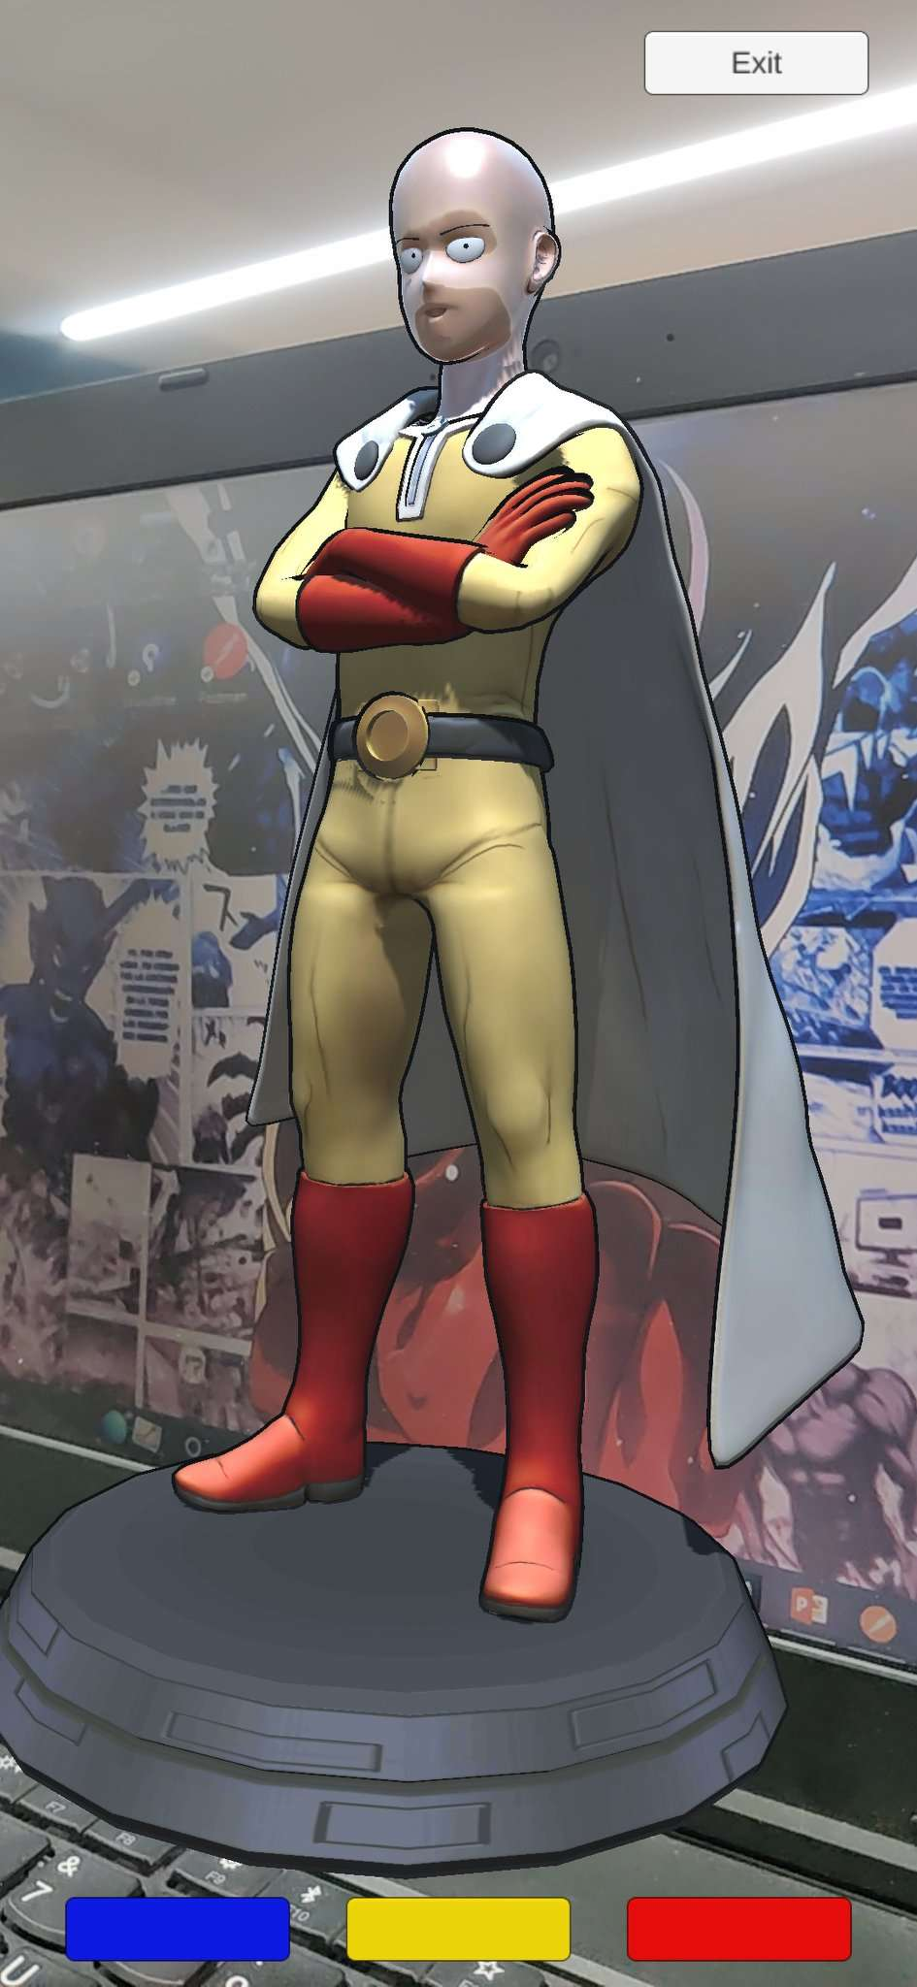
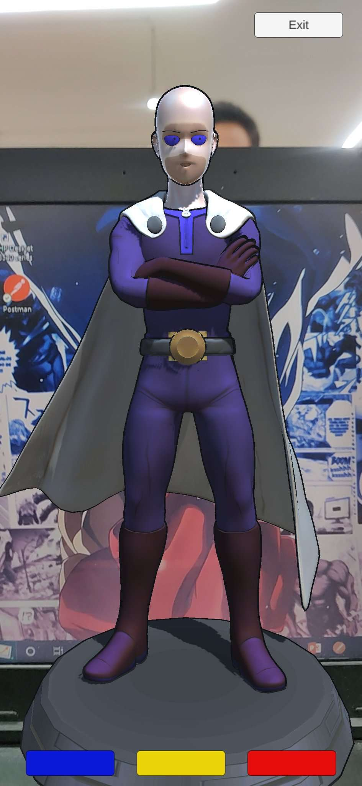
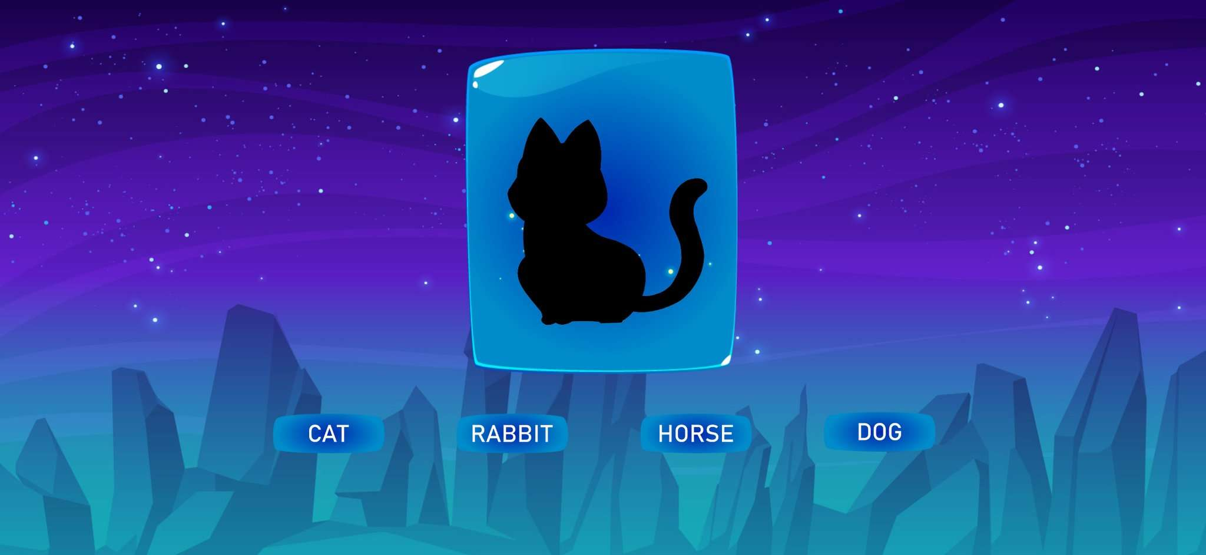
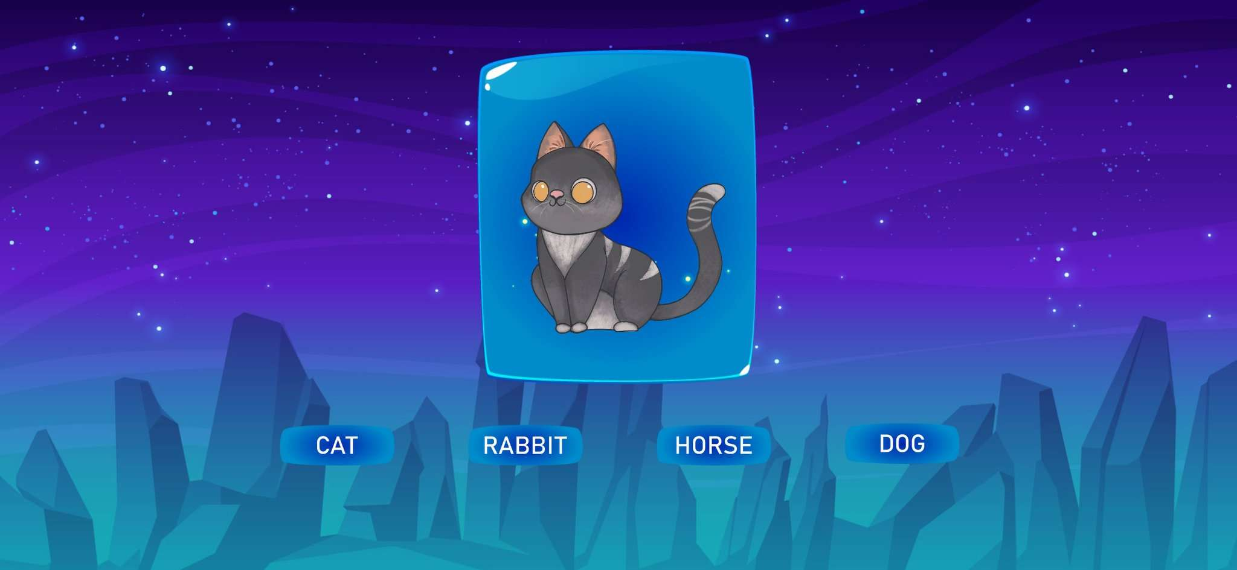
Gamification POC and AR Avatar creation.
Context:
Gamification elements.
Goal:
Improve skills of end user.
Scope:
Avatar creation.
Develop experiences to improve cognitive thinking of a child, by providing Gamified Experiences.
General Idea is to develop cognitive thinking and understanding of a child in various fields as mentioned below.
These fields are : Science, Mathematics, Emotional understanding.
Create option to create customized avatar for end user and various cosmetic items can be provided as a reward.
Some of the snapshots and POC’s of the same are shown below
https://drive.google.com/drive/folders/15JaYCrWnYs4gpqwsGKUvf9CSFi9xowNp?usp=sharing
Result:
Solutions delivered for various series projects, Helps to deliver gamified experiences for children, and improves learning.
Understeer
Oversteer

